Slide 1

EMPLOYEE MANAGEMENT SYSTEM
Presented By: KANDELA VAMSHI
Batch: 436

Slide 2
About me
Name: Kandela Vamshi
Qualification :
Bachelors In Data Science (2025)
My Profile:
AS A Passionate on Making “Data into Meaningful insight”
LinkedIn :
www.linkedin.com/in/kandela-vamshi-2b4457258
GitHub :
https://github.com/Vamshikandela/Vamshikandela

Slide 3
Agenda
Business Problem
Objective of the Project
ER Diagram and schema explanation
SQL query results with screenshots or summaries
Final business insights and recommendations
Conclusion (Key finding overall)
Q&A

Slide 4
BUSINESS PROBLEM
In MNC Companies it is difficult to manage employee details using Excel files and manual records.
As the company grows, this approach leads to confusion, data errors, and delays in salary processing.
Managers find it difficult to track employee attendance, roles, and performance in one place.
Generating reports for decision-making becomes time-consuming.
To solve this, the company needs an SQL-based Employee Management System to manage employee data efficiently.

Slide 5
OBJECTIVE
To design an efficient Employee Management System that centralizes employee records and automates HR processes.
To streamline employee data handling such as attendance, roles, and performance tracking.
To minimize manual errors and improve operational efficiency through structured data management.
To support data-driven decision-making by providing accurate and real-time employee insights.

Slide 6
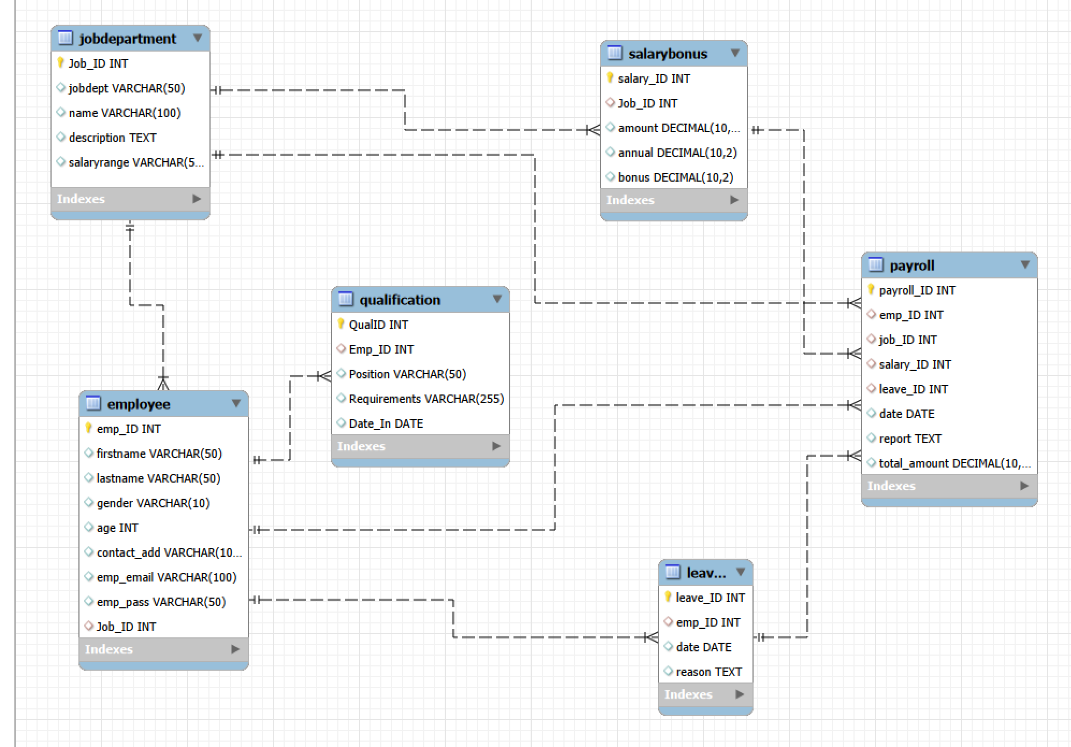
ER DIAGRAM

Slide 7
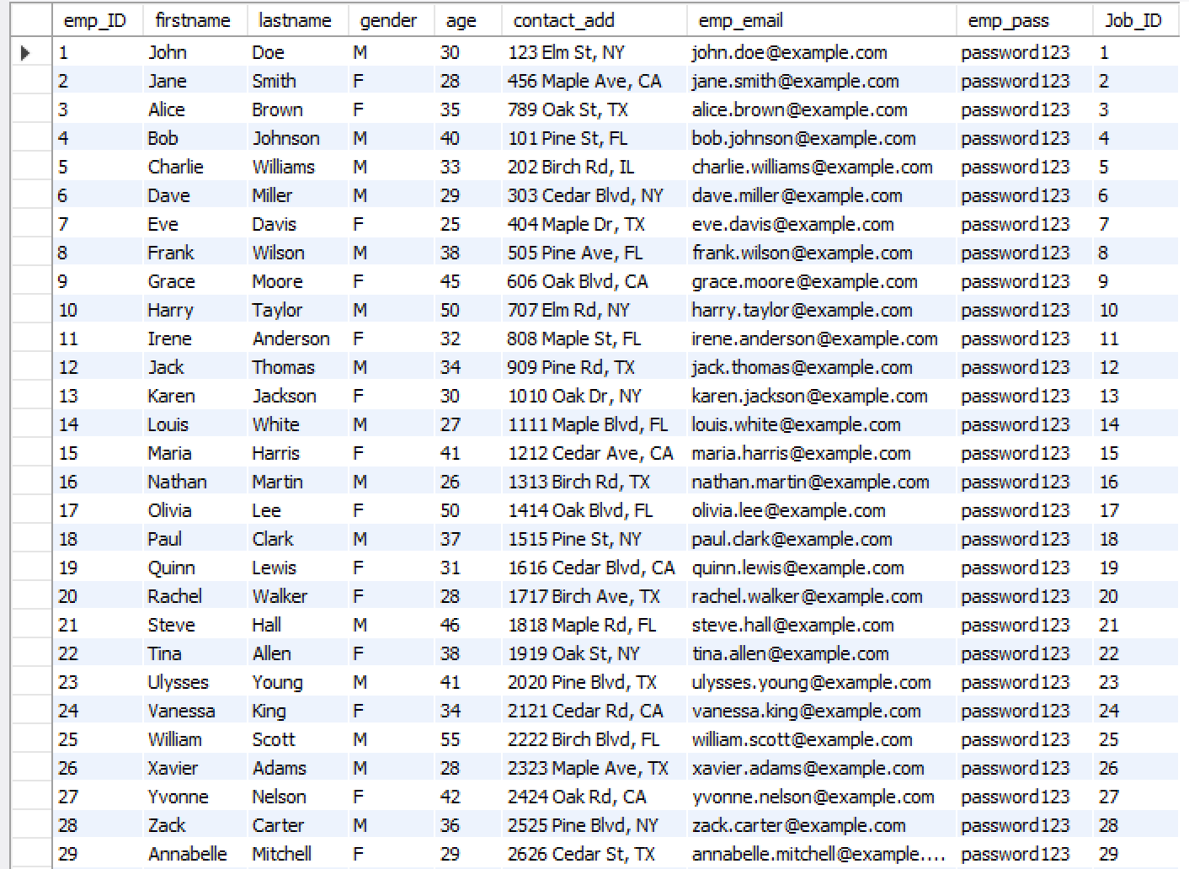
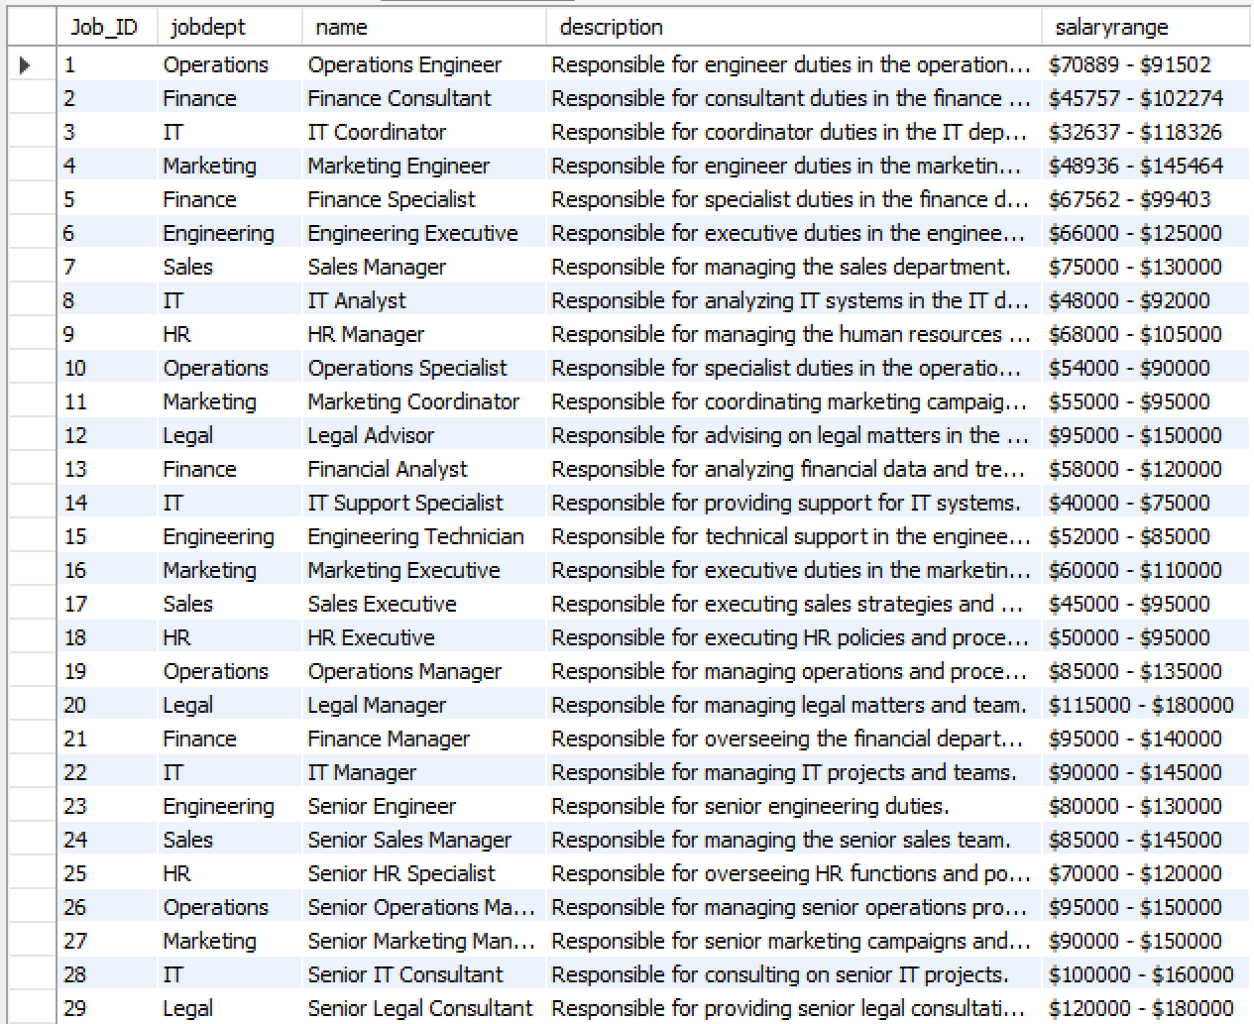
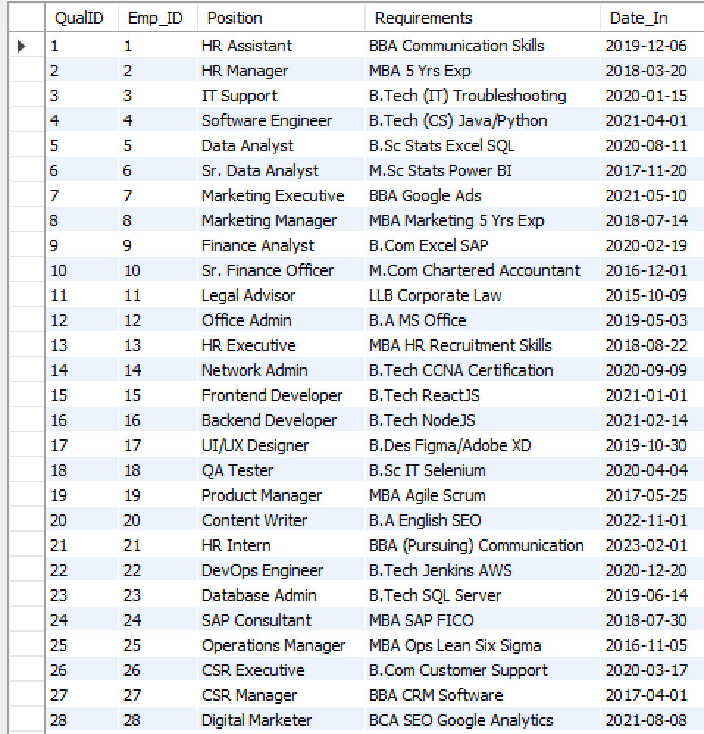
Employee Table
Job Department Table
Qualification Table

Slide 8
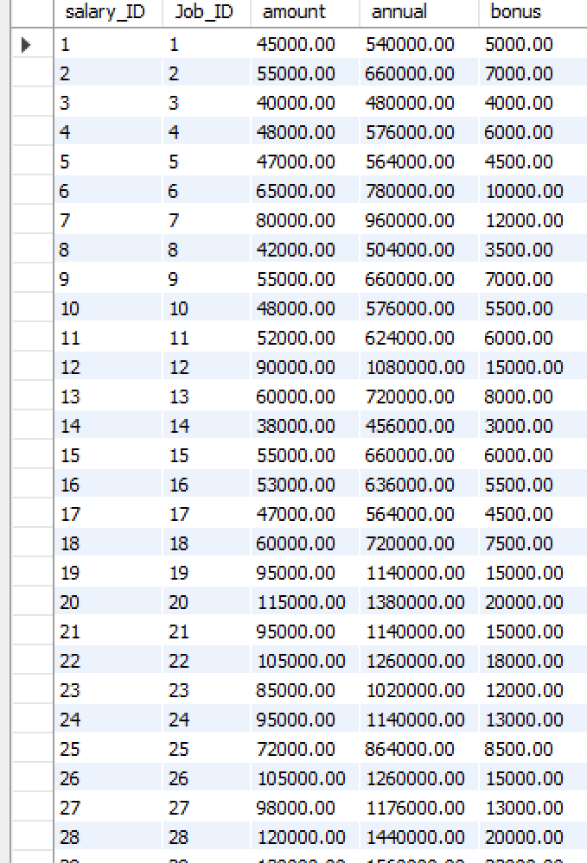
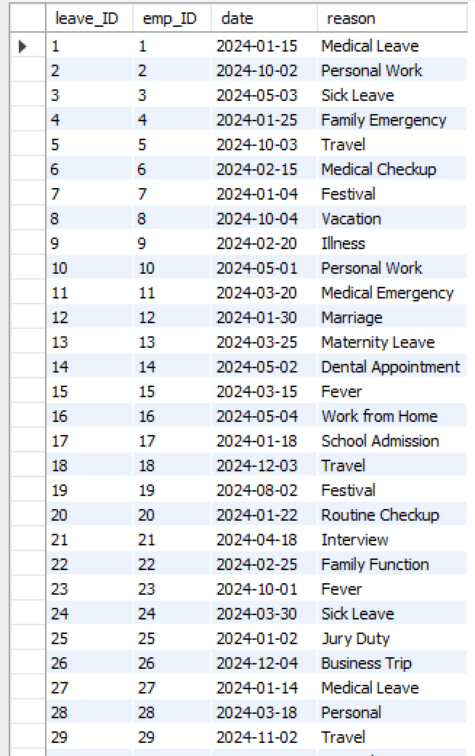
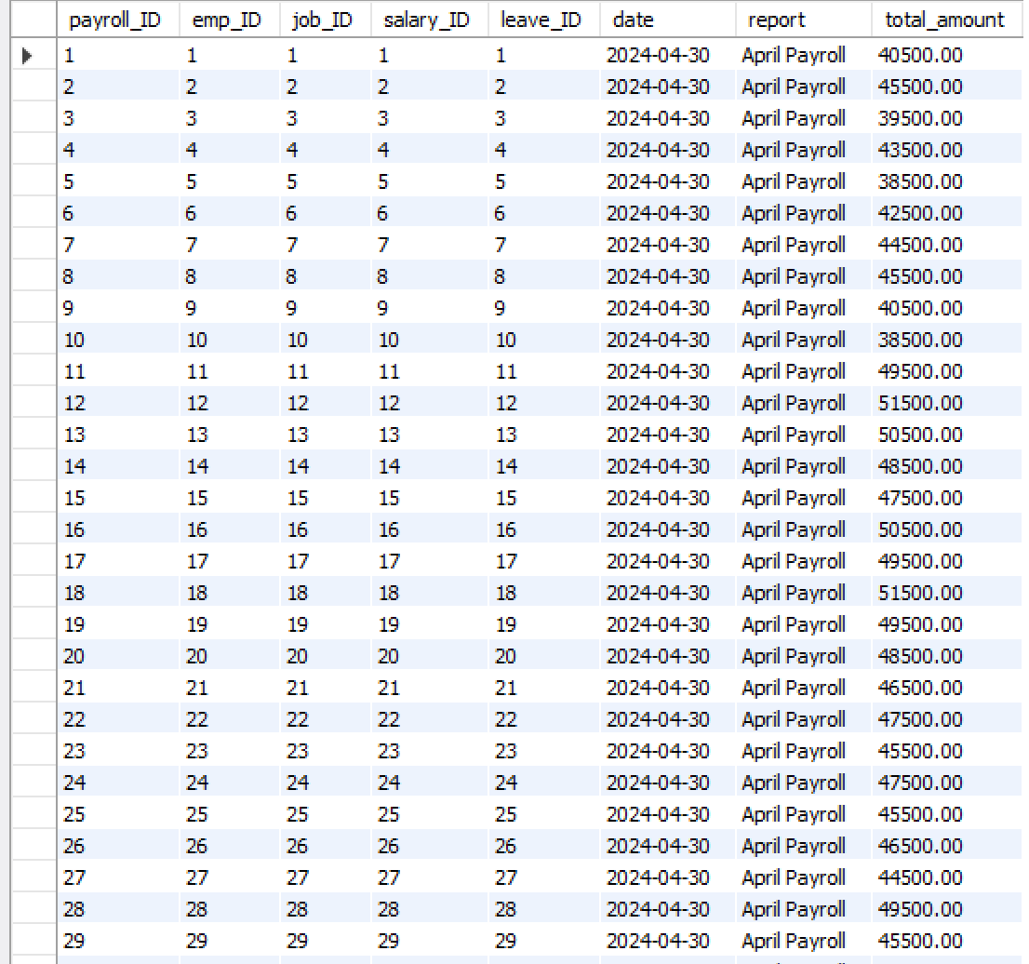
Salary Bonus Table
Leaves Table
Payroll Table

Slide 9
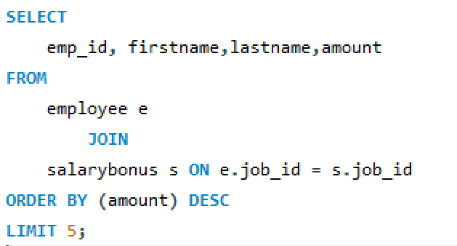
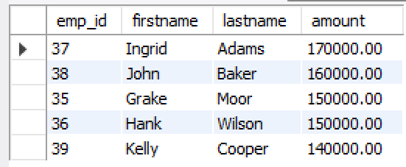
SQL query results with screenshots or summaries
Who are the top 5 highest-paid employees?
Output
Query

Slide 10
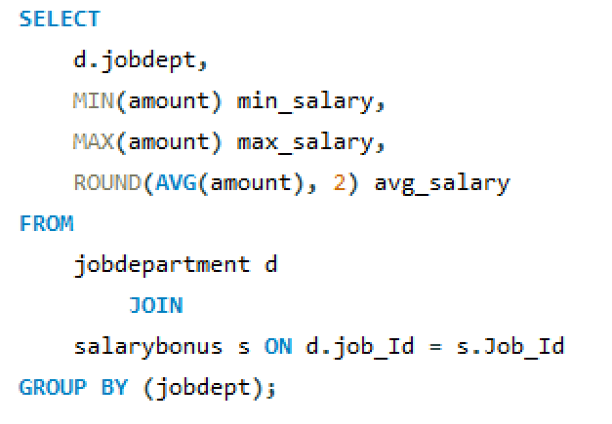
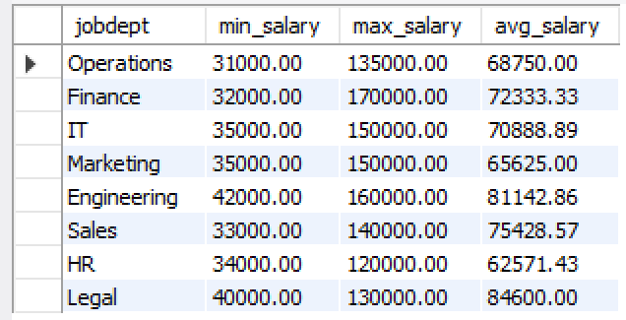
What is the average salary range per department?
Output
Query

Slide 11
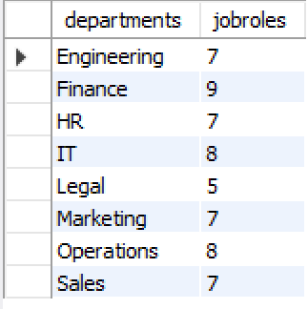
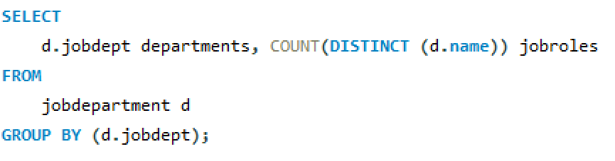
How many different job roles exist in each department?

Slide 12
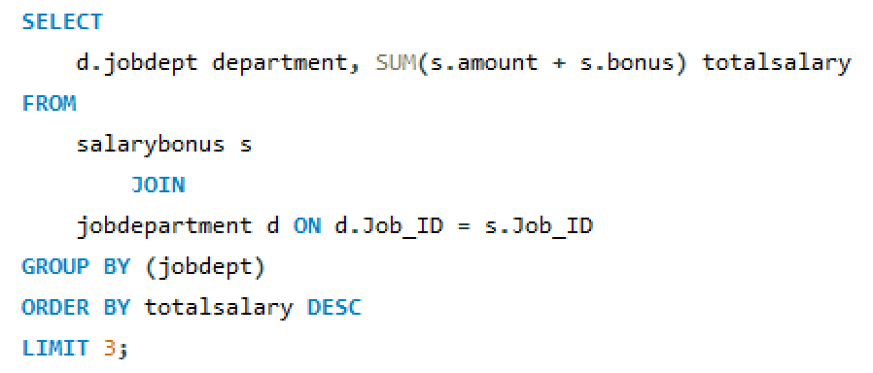
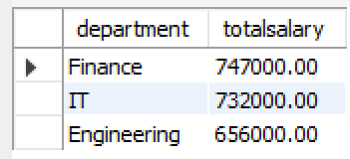
Which departments have the highest total salary allocation?

Slide 13
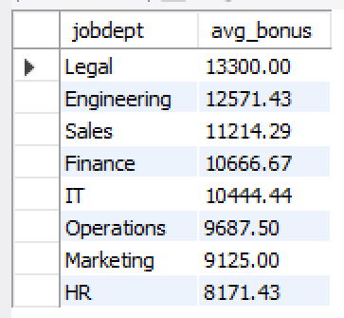
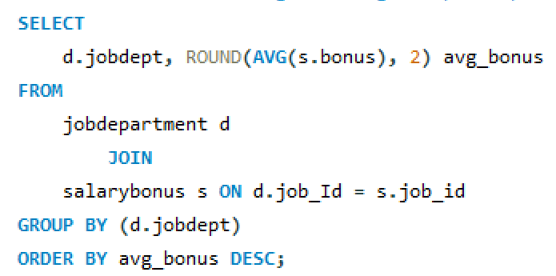
What is the average bonus given per department?

Slide 14
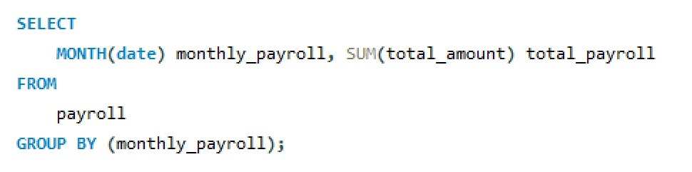
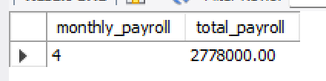
What is the total monthly payroll processed?

Slide 15
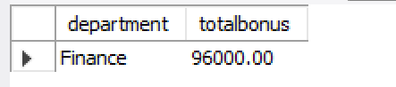
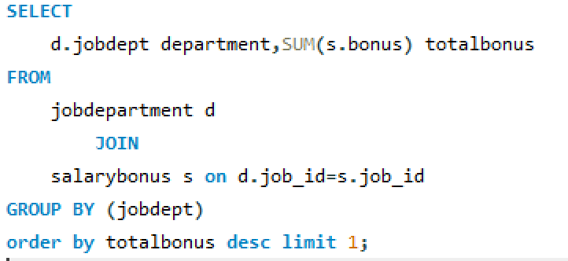
Which department receives the highest total bonuses?

Slide 16
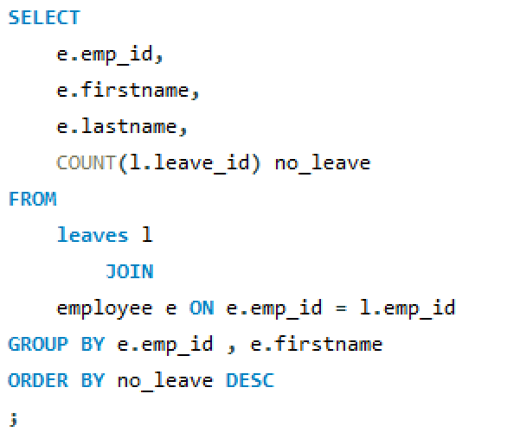
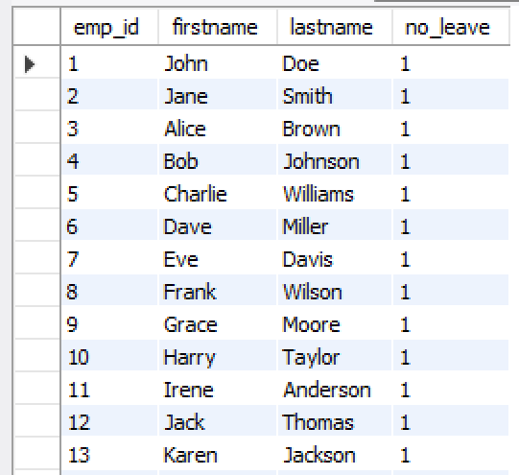
Which employees have taken the most leaves?

Slide 17
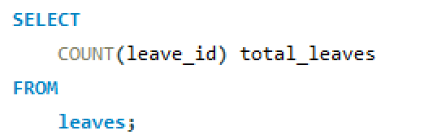

What is the total number of leave days taken company-wide?

Slide 18
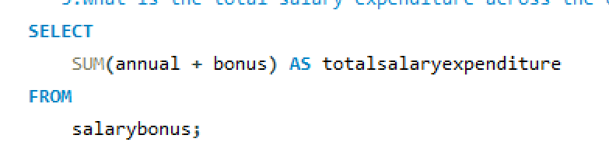
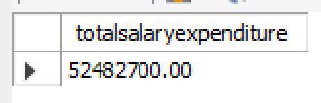
What is the total salary expenditure across the company?

Slide 19
Final business insights
Finance, IT, and Engineering departments account for the highest salary and bonus expenditures, indicating strong investment in core business functions.
Top-paid employees are concentrated in specialized roles, reflecting market-driven compensation strategies.
Bonus allocation varies by department, with Finance leading, highlighting performance-based reward structures.
Leave utilization is controlled and evenly distributed, suggesting effective workforce management and stable employee engagement.
Recommendations
Review high-compensation roles to ensure performance alignment.
Balance departmental salary and bonus budgets with business outcomes.
Strengthen fair, performance-linked incentive structures.
Use workforce data to support smarter HR and financial planning.

Slide 20
Conclusion
The Employee Management System provides clear visibility into salary, bonus, and leave patterns across departments.
Insights show that compensation is strategically focused on high-impact roles and core business functions.
Balanced leave usage reflects a stable and well-managed workforce.
Overall, the system enables data-driven HR decisions, cost control, and improved workforce planning.

Slide 21


Slide 22

THANK YOU

